Slide 1

GenAI in .NET Development
Discover how to leverage the power of Generative AI in .NET applications with Console, CI/CD pipelines and LM Studio integration.

Slide 2
Objectives
Understand the concept and application of LLM/GenAI in software development.
Automatically generate unit tests from C# code using local AI model (LM Studio).
Know how to structure a standardized .NET project with Test Project.
Create and connect GitHub repository from Visual Studio.
Configure GitHub Actions workflow for automated testing (CI).
Combine tools to increase professionalism & automate the development process.

Slide 3




What is Generative AI?
Definition
Capabilities
AI systems that create new content based on patterns learned from training data.
Generates code, text, images, audio, and video from simple prompts.
Notable Models
GPT-4, Claude, Mistral, Mixtral, and more evolve rapidly.

Slide 4
What is Generative AI? – cont’s
Mainly based on advanced Deep Learning techniques, such as:
Generative Adversarial Networks (GANs)
Variational Autoencoders (VAEs)
Transformers
Diffusion Models
Notes:
https://www.microsoft.com/en-us/ai/ai-101/what-is-generative-ai

Slide 5
Differences between traditional AI and GenAI
Traditional AI: prediction, classification based on structured data.
GenAI: creation, synthesis of new content - for example code generation, documentation writing...
Strong in NLP, effective support for modern developers.
Notes:
https://www.microsoft.com/en-us/ai/ai-101/generative-ai-vs-other-types-of-ai

Slide 6
GenAI integration points into the software development lifecycle
Analysis phase: create specifications from prompts.
Development phase: generate code, services, controllers.
Testing phase: generate automated tests, check logic.
Operation phase: technical support chatbot, log analysis.

Slide 7
Benefit of GenAI
Increase software development speed (productivity boost).
Reduce logic errors thanks to AI-assisted review.
Save time writing tests and documents.
Communicate with internal systems via specialized chatbots.

Slide 8
Examples of generative AI in action
Generative AI has a range of applications across a variety of fields and industries. Some notable examples include:
Human-like text generation.
Image creation.
Audio generation.
Video creation.

Slide 9





GenAI Integration in .NET
Backend Code Generation
Automatically create Services, DTOs, and Controllers from descriptive prompts.
Unit Test Creation
Generate comprehensive xUnit or NUnit tests for your code.
API Documentation
Auto-generate Swagger specs and XML documentation for your APIs.
Support Chatbot
Build internal chatbots that understand your codebase.

Slide 10






OpenAI API Code Generation
Generated Code
Ready-to-use C# components
Processing Response
Parse JSON and extract code
API Request
Send structured prompt with examples

Slide 11








CI/CD Pipeline Integration
Source Control
Build & Test
Commit code to GitHub/Azure DevOps
Compile and run AI-generated tests
Deployment
Quality Gates
Release to staging and production
Validate AI outputs meet standards

Slide 12
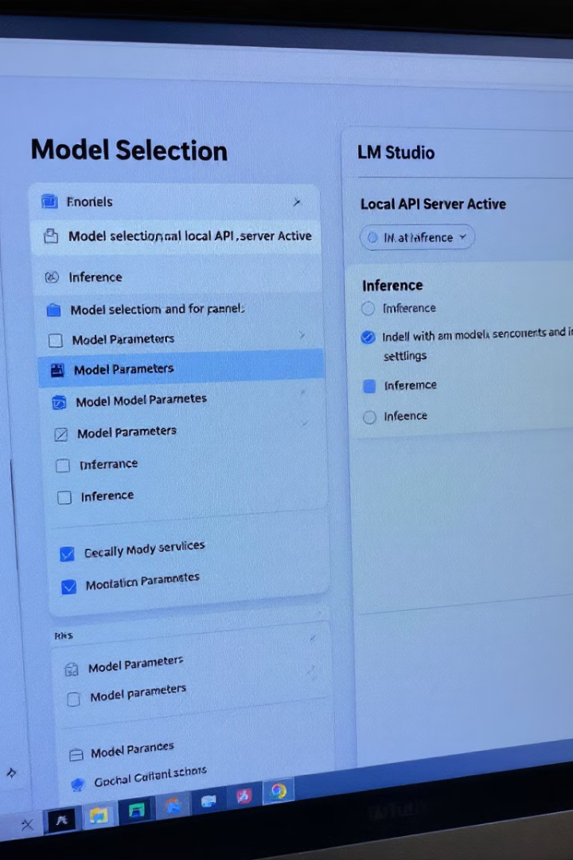
LM Studio for Local Models
What is LM Studio?
Model Configuration
Desktop application for running LLMs locally without relying on cloud services. Provides a user-friendly interface for model management.
Download optimized models like Mistral-7B or Mixtral-8x7B. Adjust parameters for speed/quality balance.
.NET Integration
Connect via REST API using HttpClient. Structure requests similar to OpenAI format.

Slide 13
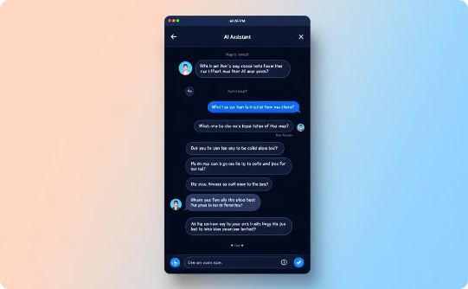
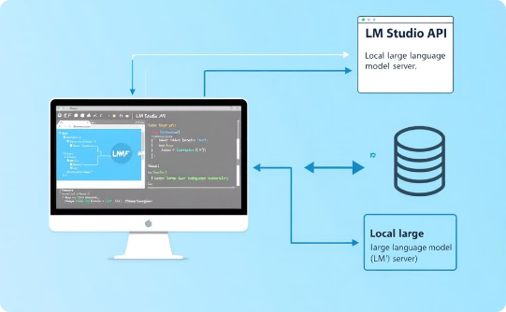
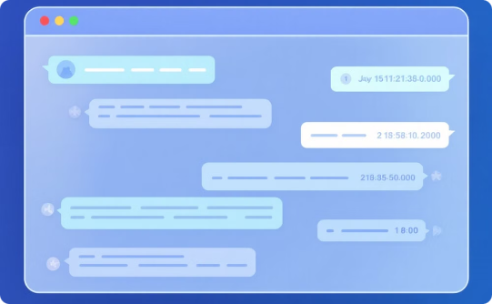
Chatbot Implementation
Chat Interface
Backend Communication
History Management
Design an intuitive chat UI with message bubbles and input area.
Create services to manage context and handle API calls to LM Studio.
Implement conversation memory for contextual responses.

Slide 14

Best Practices & Future Trends
Security Considerations
Validate AI outputs before execution. Never run generated code without review. Use sandboxing for testing.
Performance Optimization
Cache responses for similar prompts. Use smaller models for simpler tasks. Implement request batching.
Future Developments
Specialized .NET coding models. Native integration in Visual Studio. Automated code reviews and refactoring.

Slide 15
Debug with GitHub Copilot in Visual Studio
Copilot can provide code fixes along with in-depth analysis and explanations of how code works. It helps with proposed fixes to bugs, and explains things such as exceptions.
Copilot understands call stacks, frames, variable names, and values.
It interacts with the debugger-aware AI to ask detailed questions related to code and to debugging issues in general.
It provides more precise help for some targeted scenarios, such as Exceptions, and all those described in AI-enhanced scenarios for debugging

Slide 16
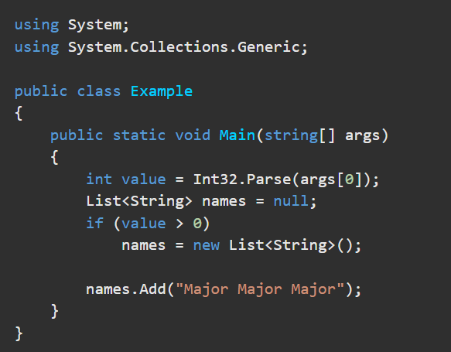
Debug using Copilot - 1
In Visual Studio, create a new C# Console app.
On the start window, choose Create a new project. Type console in the search box, select C# as the language, and then choose Console App for .NET. Choose Next. Type a project name like ConsoleApp_Copilot and select Next.
Choose either the recommended target framework or .NET 8, and then choose Create.
If you don't see the Console App project template for .NET, go to Tools > Get Tools and Features, which opens the Visual Studio Installer. Choose the .NET desktop development workload, then choose Modify.
Visual Studio creates the console project, which appears in Solution Explorer in the right pane.
Replace the code in Program.cs with the following code:

Slide 17
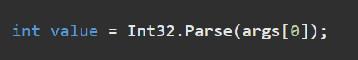
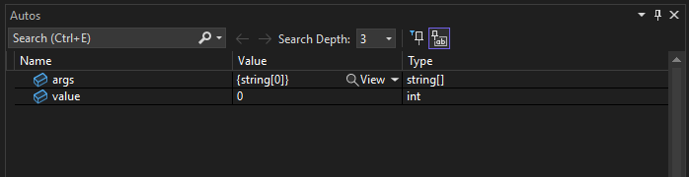
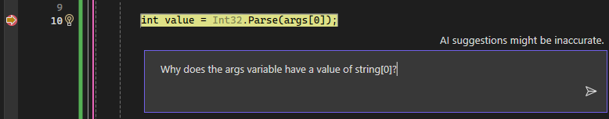
Debug using Copilot – 2
7. Right-click the following statement and choose Breakpoint > Insert Breakpoint.
8. Press F5 or select Start Debugging from the Debug menu.
The app pauses at the breakpoint. The Autos window shows that the args variable has a value of string[0].
9. Right-click in the code and choose Ask Copilot to open the inline Chat view.
10. Type the following question in the inline Chat view: “Why does the args variable have a value of string[0]?”

Slide 18
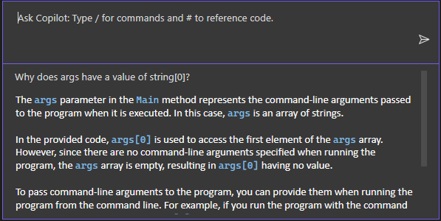
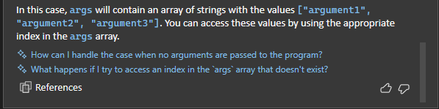
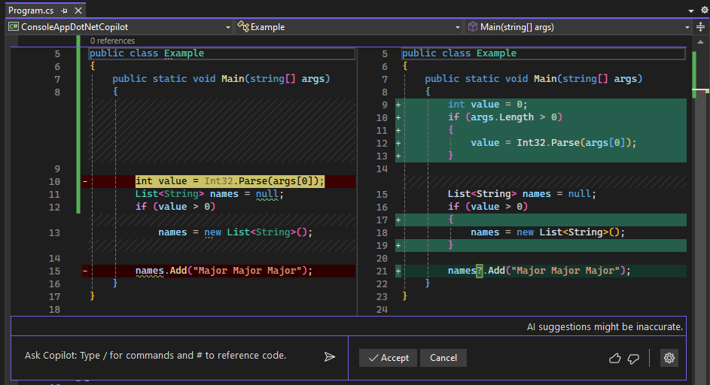
Debug using Copilot – 3
When you press Enter, Copilot provides an answer based on its understanding of your code. (You might get a different response than what is shown here.)
If Copilot has a suggested fix for your code, it shows you. If not, you can ask Copilot for a code suggestion.
Scroll to the end of the Copilot answer and select the follow-up question at the end of the inline Chat window, "How can I handle the case when no arguments are passed to the program?"

Slide 19
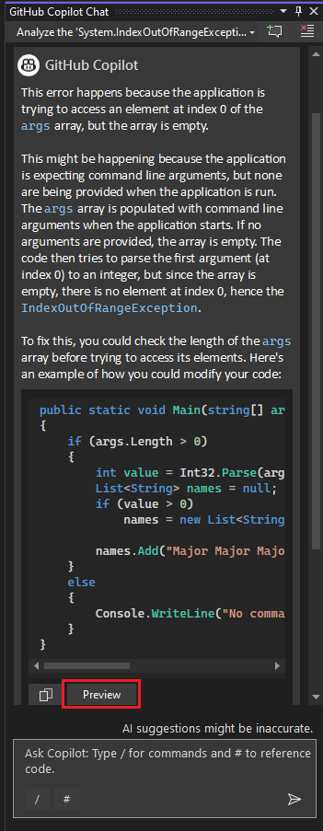
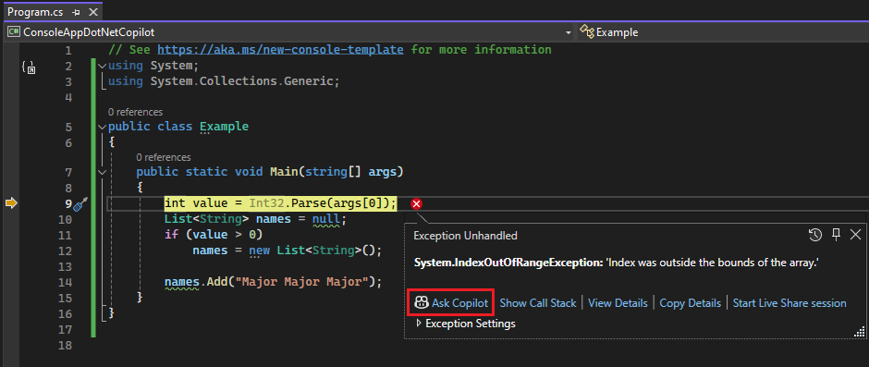
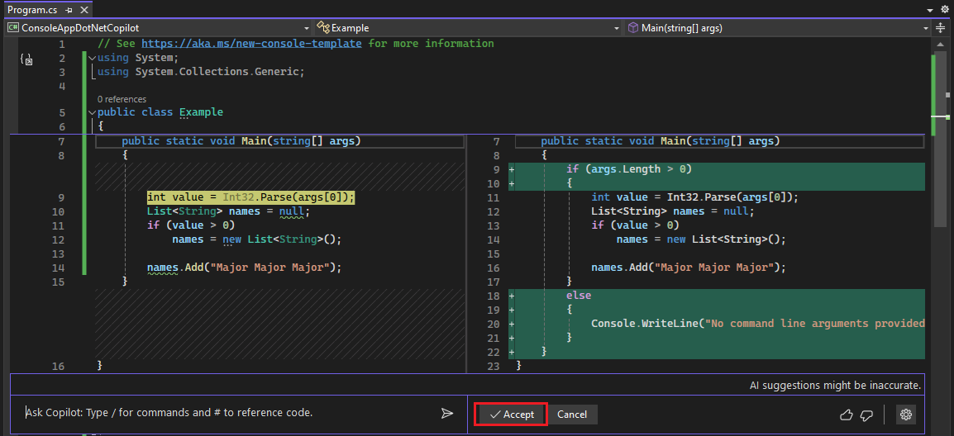
Debug an exception with Copilot - Ask for AI assistance
With the application paused on the exception, select the Ask Copilot button.

Slide 20
AI-enhanced scenarios
Copilot understands call stacks, frames, variable names, and values. As a result, you can interact with the debugger-aware AI to ask detailed questions related to your code and to debugging issues in general.
In addition, Copilot provides more precise help for some targeted scenarios, such as those described in the following table.
Feature or scenario | Link
Exceptions | See Debug an exception with Copilot Help with exceptions includes help with deadlock detection errors.
Variables | See Debug using Copilot.
Data tips | See Get AI assistance with Data tips.
Conditional breakpoints and tracepoints | See Get suggestions with conditional breakpoints and tracepoints.
Quick Actions (light bulb) | See Get AI assistance with Quick Actions.
IEnumerable tabular visualizer | See Modify the visualizer expression.
Inline return values | See View return values of method calls.
Summary thread descriptions | See Threads View (Parallel Stacks).
Auto insights for profiling | See Get AI assistance with Auto insights.

Slide 21
Using a Local LLM with .NET Console Application and GitHub CI/CD to Auto-Generate and Run Unit Tests
Objective
Use a local LLM (via LM Studio) to auto-generate unit tests for .NET code.
Interact with the LLM using a .NET Console Application.
Automatically run tests via GitHub Actions (CI/CD).
Eliminate dependence on external APIs like OpenAI by running everything locally.
This guide will help you build a .NET console application that connects directly to a locally running LLM using LM Studio. You'll input source code, and the model will generate unit tests.
Then you'll integrate GitHub and GitHub Actions to automatically execute the tests when code changes.

Slide 22
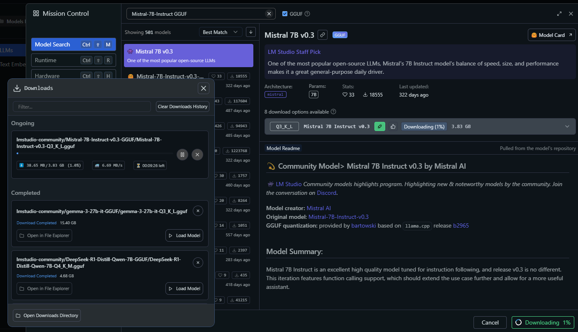
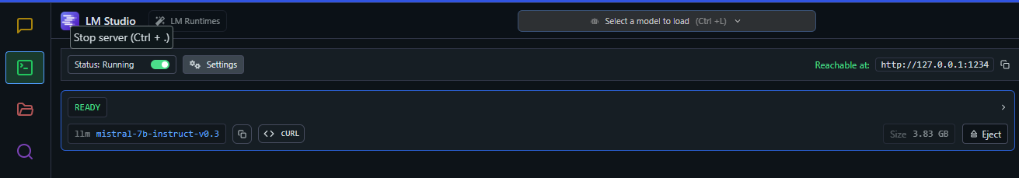
Set up LM Studio
Download and install LM Studio from https://lmstudio.ai
Select and download a model (e.g., Mistral-7B-Instruct GGUF).
Start the API Server from LM Studio GUI.
The REST endpoint will be: http://localhost:1234/v1/chat/completions
Note: The API is OpenAI-compatible.

Slide 23
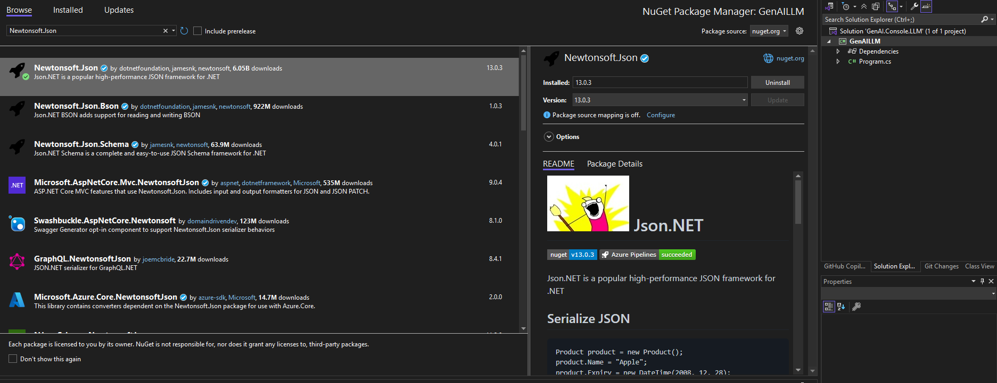
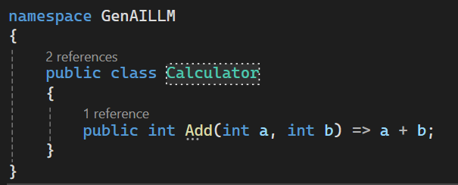
Create .NET Console App
A Console App project that interacts with GenAI (LM Studio): GenAILLM
dotnet add package Newtonsoft.Json
Create Source Code File

Slide 24
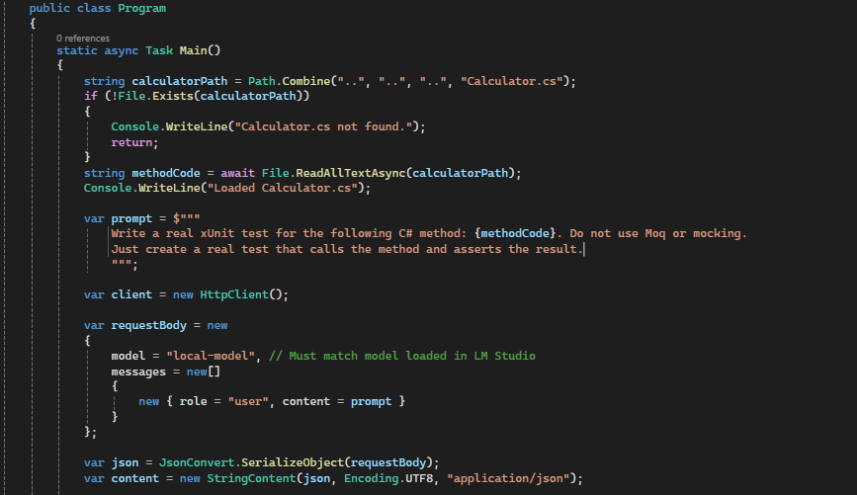
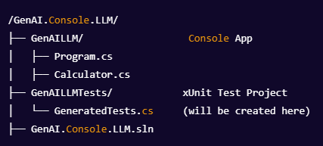
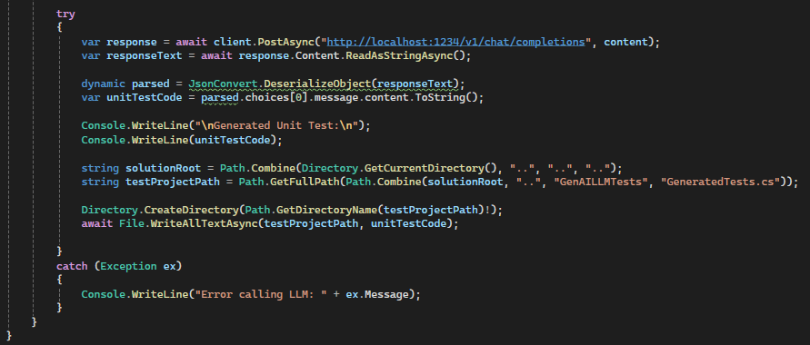
Create xUnit Test App
A separate xUnit Test project to run unit tests, including auto-generated ones
Add Reference from Test Project to Console App
dotnet new xunit -n GenAILLMTests
This project will store and run the generated tests using dotnet test.
Write Program.cs to Auto-Generate Tests

Slide 25
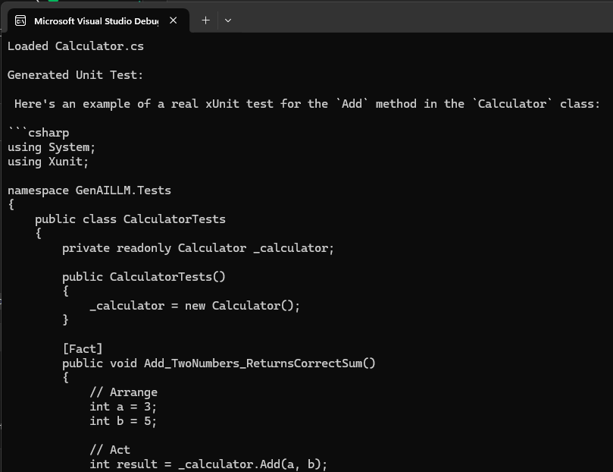
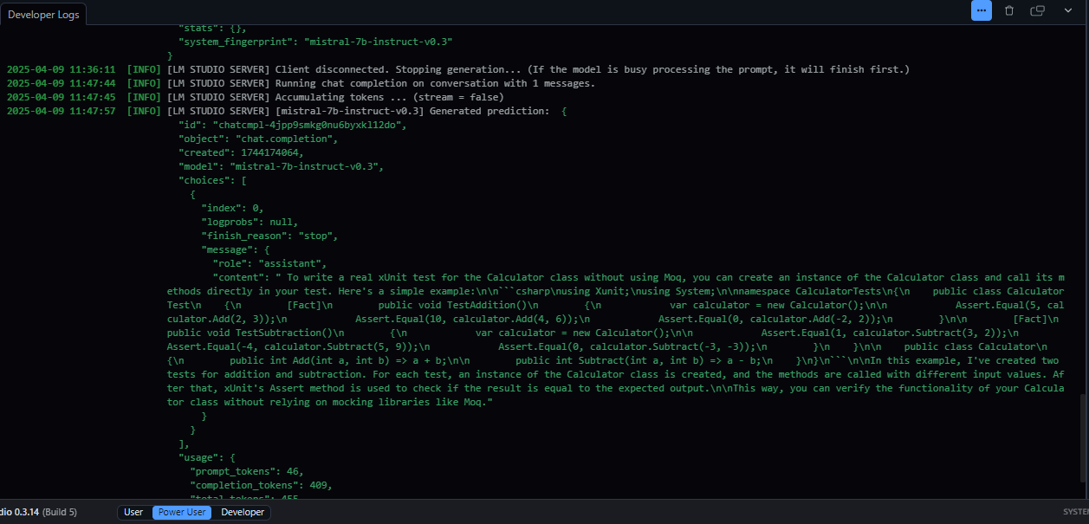
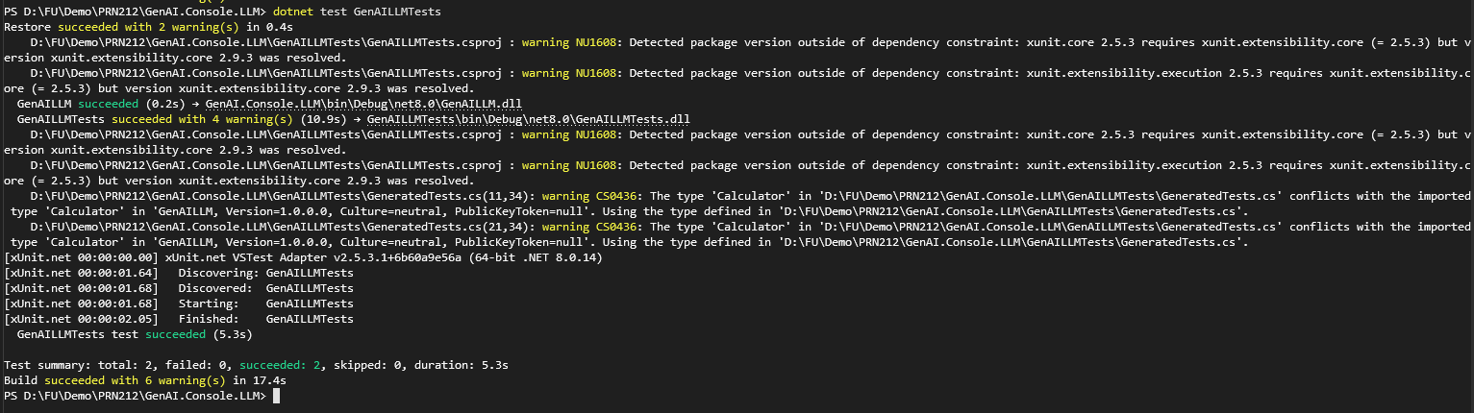
Use a local LLM generate unit tests

Slide 26
Create GitHub Repository (via Visual Studio)
Click Git (top menu) → Create Git Repository...
Select Add to Source Control
In the Git window, select:
Repository name: GenAI.Console.LLM
GitHub account (sign in if needed)
Visibility: Public or Private
Click Create and Push
Visual Studio will auto-initialize .git, push initial commit, and set origin.

Slide 27
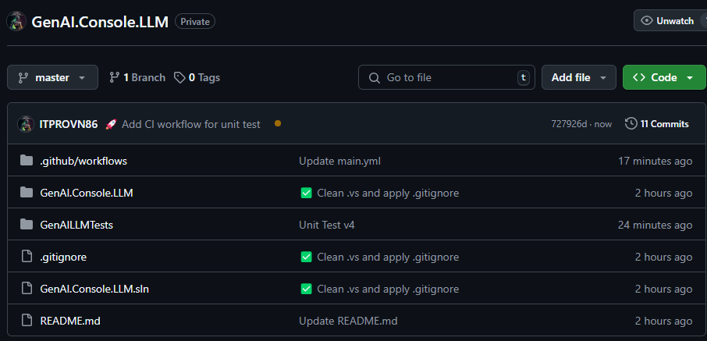
name: CI - Run GenAI Unit Tests
on:
push:
branches: [ master ]
pull_request:
branches: [ master ]
jobs:
test:
runs-on: ubuntu-latest
steps:
- name: Checkout code
uses: actions/checkout@v3
- name: Setup .NET
uses: actions/setup-dotnet@v3
with:
dotnet-version: '8.0.x'
- name: Restore dependencies
run: dotnet restore
- name: Build solution
run: dotnet build --no-restore
- name: Run tests
run: dotnet test GenAILLMTests/GenAILLMTests.csproj --no-build --filter "FullyQualifiedName~GenAILLM.Tests"
Add GitHub Actions Workflow
Create .github/workflows/genai-unittest.yml file in solution with this content:

Slide 28
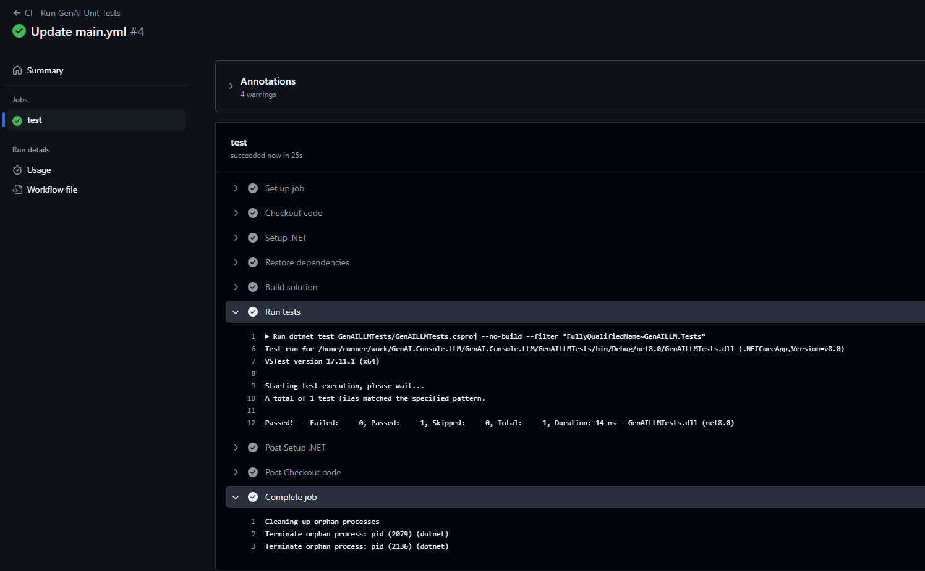
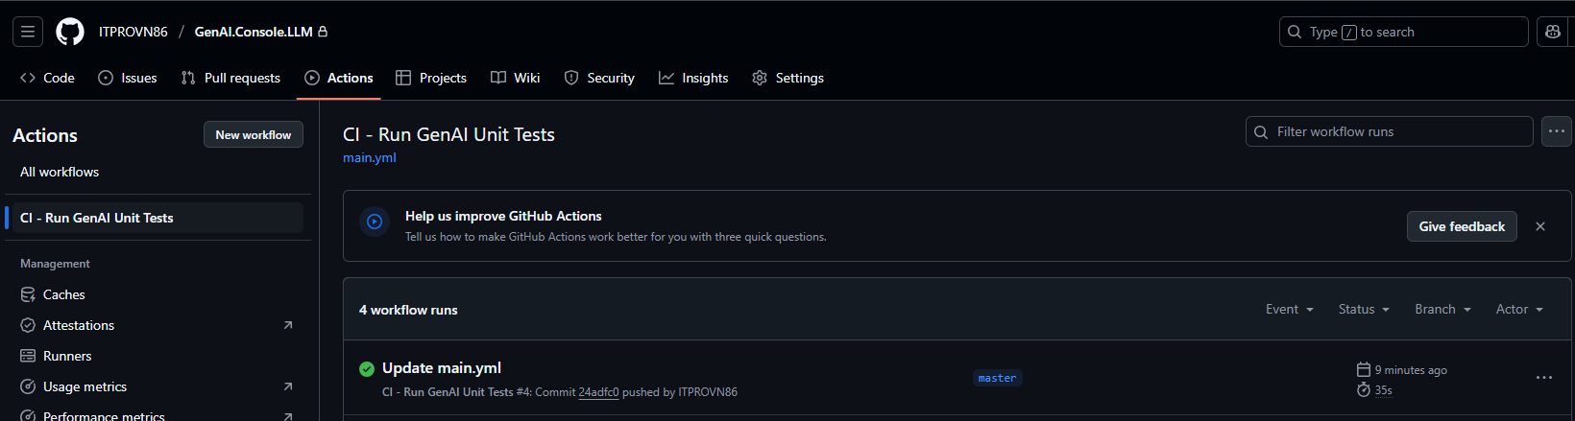
Push Again to Trigger CI/CD
git add .
git commit -m "Add CI workflow for unit test "
git push
Go to GitHub repo → Click on Actions
Test workflow running on every push/pull request

Slide 29
Summary
Concepts were introduced:
AI model creates content, applies to source code generation.
Install, download model, start API like OpenAI.
Write app to call AI and generate test file with [Fact].
Clearly separate Console App & Test Project.
Create repo, push code from Visual Studio, handle common errors.
Create .yml file for CI to automatically run test when pushing code.

Slide 30
Reference
Semantic Kernel: https://github.com/microsoft/semantic-kernel
OpenAI Docs: https://platform.openai.com/docs
GitHub Copilot: https://github.com/features/copilot
LangChain.NET: https://github.com/hwchase17/langchain-dotnet

